Slide 1
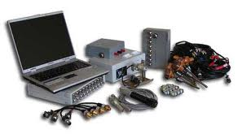
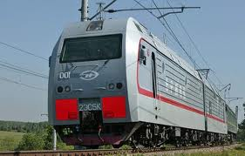
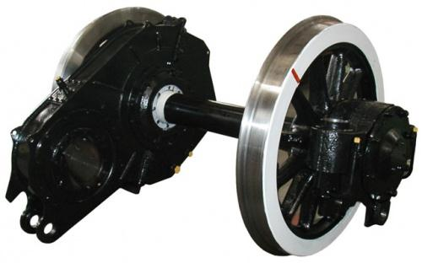
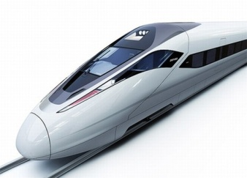
Кафедра «Локомотивы»
ДВГУПС
Certified by Russian Register
Мониторинг параметров объектов транспортной инфраструктуры
Диагностирование узлов локомотива
Испытания подвижного состава
Исследование взаимодействия колеса и рельса
Научно-техническое сопровождение новой и модернизированной техники
Приоритетные
направления
Проектирование автоматизированных систем управления
Оптимизация процессов ремонта локомотивов
Снижение непроизводительных затрат электроэнергии
Развитие кадрового потенциала
Реализация технологий бережливого производства
Notes:
3-D cyclical shapes
(Difficult)
Tip: Some shape effects on this slide are created with the Combine Shapes commands. To access this command, you must add it to the Quick Access Toolbar, located above the File tab. To customize the Quick Access Toolbar, do the following:
Click the arrow next to the Quick Access Toolbar, and then under Customize Quick Access Toolbar click More Commands.
In the PowerPoint Options dialog box, in the Choose commands from list, select All Commands.
In the list of commands, click Combine Shapes, and then click Add.
To reproduce the first shape on this slide, do the following:
On the Home tab, in the Slides group, click Layout, and then click Blank.
Also on the Home tab, in the Drawing group, click Shapes, and then under Basic Shapes click Oval (first row).
On the slide, drag to draw an oval.
Select the oval. Under Drawing Tools, on the Format tab, in the Size group, enter 4.25” into the Height box and 4.25” into the Width box.
Also on the Format tab, in the Shape Styles group, click Shape Fill, and then click No Fill.
On the Home tab, in the Drawing group, click Shapes, and then under Basic Shapes click Pie (second row).
On the slide, drag to draw a pie.
Select the pie shape. Under Drawing Tools, on the Format tab, in the Size group, enter 4” into the Height box and 4” into the Width box.
Press and hold CTRL, and select the oval and the pie. Also on the Format tab, in the Arrange group, click Align, and then do the following:
Click Align to Slide.
Click Align Center.
Click Align Middle
Select the pie shape. Drag the yellow diamond adjustment handles to create a half-circle shape, with the rounded edge facing the top of the slide.
On the Home tab, in the Drawing group, click Shapes, and then under Basic Shapes click Oval (first row)
On the slide, drag to draw an oval.
Select the second oval. Under Drawing Tools, on the Format tab, in the Size group, enter 3” into the Height box and 3” into the Width box.
Move the second oval to the center of the first oval.
Press and hold CTRL, and select the pie and the second oval. Also on the Format tab, in the Arrange group, click Align, and then do the following:
Click Align Selected Objects.
Click Align Right.
Click Align Middle.
Press and hold CTRL, select the pie, and then select the second oval. On the Quick Access Toolbar, click Combine Shapes, and then click Shape Subtract.
Also on the Home tab, in the Drawing group, click Shapes, and under Basic Shapes click Oval.
On the slide, drag to draw an oval.
Select the new oval. Under Drawing Tools, on the Format tab, in the Size group, enter 1” into the Height box and 1” into the Width box.
Select the new oval. Also on the Format tab, in the Arrange group, do the following:
Click Align to Slide.
Click Align Middle.
Click Align Center.
Press and hold CTRL, and select the new oval and the freeform shape. Also on the Format tab, in the Arrange group, do the following:
Click Align Selected Objects.
Click Align left.
Press and hold CTRL, and select the new oval and the freeform shape. On the Quick Access Toolbar, click Combine Shapes, and then click Shape Union.
To reproduce the second and third curved freeform shapes, do the following:
Press and hold CTRL, and select the freeform shape and the oval. Also on the Format tab, in the Arrange group, click Group, and the click Group.
Select the group of shapes. On the Home tab, in the Clipboard group, click the arrow to the right of Copy, and then click Duplicate.
Select the duplicate group of shapes. Under Drawing Tools, on the Format tab, in the Size group, click the Size and Position dialog box launcher. In the Format Shape dialog box, click Size in the left pane, and in the Size pane, under Size and rotate, in the Rotation box enter 120°.
Press and hold CTRL, and select both groups of shapes. Also on the Format tab, in the Arrange group, do the following:
Click Align to Slide.
Click Align Middle.
Click Align Center.
Select the first group of shapes. On the Home tab, in the Drawing group, click Arrange, and then click Ungroup.
Select the duplicate group of shapes. On the Home tab, in the Drawing group, click Arrange, and then click Ungroup.
Press and hold CTRL, select the first freeform shape, and then the duplicate freeform shape. On the Quick Access Toolbar, click Combine Shapes, and then click Shape Subtract.
Press and hold CTRL, and select the freeform shape and an oval. On the Home tab, in the Drawing group, click Arrange, and then click Group.
Select the group. On the Home tab, in the Clipboard group, click the arrow to the right of Copy, and then click Duplicate. Repeat this process until there is a total of three groups.
Select a group. Under Drawing Tools, on the Format tab, in the Size group, click the Size and Position dialog box launcher. In the Format Shape dialog box, click Size in the left pane, and in the Size pane, under Size and rotate, in the Rotation box enter 120°.
Select another group. Under Drawing Tools, on the Format tab, in the Size group, click the Size and Position dialog box launcher. In the Format Shape dialog box, click Size in the left pane, and in the Size pane, under Size and rotate, in the Rotation box enter 240°.
Press and hold CTRL, and select all three groups of shapes. Also on the Format tab, in the Arrange group, do the following:
Click Align to Slide.
Click Align Middle.
Click Align Center.
Select a group. Under Drawing Tools, on the Format tab, in the Arrange group, click Ungroup. Repeat this process for each of the groups.
Select an oval and then press DELETE to delete the oval. Repeat the process for each oval.
Select the top, left freeform shape. Under Drawing Tools, on the Format tab, in the Shape Styles group, click the Format Shape dialog box launcher. In the Format Shape dialog box, click Fill in the left pane, in the Fill pane, select Solid fill, and then click the button next to Color, under Theme Colors, click Olive Green, Accent 3, Darker 25%.
Also in the Format Shape dialog box, click 3-D Format in the left pane, and in the 3-D Format pane, do the following:
Under Bevel, click the button next to Top, and then click Slope.
Next to Top, in the Width box, enter 10 pt.
Next to Top, in the Height box, enter 5 pt.
Under Depth, click the button next to Color and then click Olive Green, Accent 3, Darker 25%.
Also under Depth, in the Depth box, enter 36 pt.
Select the bottom freeform shape. Under Drawing Tools, on the Format tab, in the Shape Styles group, click Shape Fill, point to Gradients, and then click More Gradients. In the Format Shape dialog box, click Fill in the left pane, in the Fill pane , click Gradient fill, and then do the following:
In the Type list, click Linear.
In the Angle box, enter 0°.
Under Gradient stops, click Add gradient stops or Remove gradient stops until three stops appear in the slider.
Also under Gradient stops, select Rotate with shape.
Also under Gradient stops, customize the gradient stops as follows:
Select the first stop in the slider, and then do the following:
In the Position box, enter 0%.
Click the button next to Color, click More Colors, and then in the Colors dialog box, on the Custom tab, enter values for Red: 129, Green: 84, and Blue: 25.
In the Transparency box, enter 0%.
Select the next stop in the slider, and then do the following:
In the Position box, enter 20%.
Click the button next to Color, click More Colors, and then in the Colors dialog box, on the Custom tab, enter values for Red: 204, Green: 151, and Blue: 0.
In the Transparency box, enter 0%.
Select the last stop in the slider, and then do the following:
In the Position box, enter 81%.
Click the button next to Color, click More Colors, and then in the Colors dialog box, on the Custom tab, enter values for Red: 255, Green: 236, and Blue: 93.
In the Transparency box, enter 0%.
Also in the Format Shape dialog box, click 3-D Format in the left pane, and in the 3-D Format pane, do the following:
Under Bevel, click the button next to Top, and then click Slope.
Next to Top, in the Width box, enter 10 pt.
Next to Top, in the Height box, enter 5 pt.
Under Depth, click the button next to click More Colors, and then in the Colors dialog box, on the Custom tab, enter values for Red: 129, Green: 84, and Blue: 25.
Also under Depth, in the Depth box, enter 36 pt.
Select the right freeform shape. Under Drawing Tools, on the Format tab, in the Shape Styles group, click Shape Fill, point to Gradients, and then click More Gradients. In the Format Shape dialog box, click Fill in the left pane, in the Fill pane , click Gradient fill, and then do the following:
In the Type list, click Linear.
In the Angle box, enter 0.
Under Gradient stops, click Add gradient stops or Remove gradient stops until three stops appear in the slider.
Also under Gradient stops, select Rotate with shape.
Also under Gradient stops, customize the gradient stops as follows:
Select the first stop in the slider, and then do the following:
In the Position box, enter 0%.
Click the button next to Color, click More Colors, and then in the Colors dialog box, on the Custom tab, enter values for Red: 117, Green: 21, and Blue: 21.
In the Transparency box, enter 0%.
Select the next stop in the slider, and then do the following:
In the Position box, enter 30%.
Click the button next to Color, click More Colors, and then in the Colors dialog box, on the Custom tab, enter values for Red: 194, Green: 40, and Blue: 14.
In the Transparency box, enter 0%.
Select the last stop in the slider, and then do the following:
In the Position box, enter 74%.
Click the button next to Color, click More Colors, and then in the Colors dialog box, on the Custom tab, enter values for Red: 243, Green: 72, and Blue: 3.
In the Transparency box, enter 0%.
Also in the Format Shape dialog box, click 3-D Format in the left pane, and in the 3-D Format pane, do the following:
Under Bevel, click the button next to Top, and then click Slope.
Next to Top, in the Width box, enter 10 pt.
Next to Top, in the Height box, enter 5 pt.
Under Depth, click the button next to click More Colors, and then in the Colors dialog box, on the Custom tab, enter values for Red: 117, Green: 21, and Blue: 21.
Also under Depth, in the Depth box, enter 36 pt.
Press and hold CTRL, and select all three freeform shapes. On the Home tab, in the Drawing group, click Arrange, and then click Group.
Select the group. Also on the Home tab, in the Drawing group, click the Format Shape dialog box launcher. In the Format Shape dialog box, click 3-D Rotation in the left pane, in the 3-D Rotation pane, click the button next to Presets, and then under Perspective, click Perspective Relaxed Moderately.
Also in the Format Shape dialog box, click Shadow in the left pane, and in the Shadow pane, do the following:
Click the button next to Presets, under Perspective, click Below.
In the Transparency box, enter 70%.
In the Size box, enter 90%.
In the Blur box, enter 26 pt.
In the Angle box, enter 90°.
In the Distance box, enter 0 pt.
To reproduce the background effects on this slide, do the following:
On the Design tab, in the Background group, click Background Styles, and then click Format Background. In the Format Background dialog box, click Fill in the left pane, in the Fill pane, click Gradient fill, and then do the following:
In the Type list, click Linear.
In the Angle box, enter 90°.
Under Gradient stops, click Add gradient stops or Remove gradient stops until two stops appear in the slider.
Also under Gradient stops, customize the gradient stops as follows:
Select the first stop in the slider, and then do the following:
In the Position box, enter 0%.
Click the button next to Color, and then under Theme Colors click Black, Text 1 (first row).
Select the next stop in the slider, and then do the following:
In the Position box, enter 19%.
Click the button next to Color, and then under Theme Colors click Black, Text 1, Lighter 35% (third row).
Select the final stop in the slider, and then do the following:
In the Position box, enter 62%.
Click the button next to Color, and then under Theme Colors click White, Background 1, Darker 15% (first row, first option from the left).

Slide 2
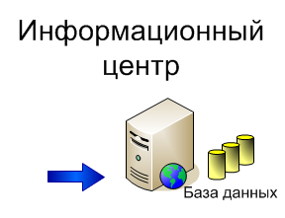
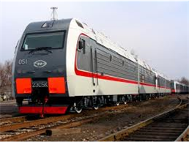
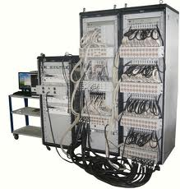
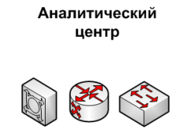
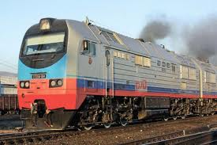
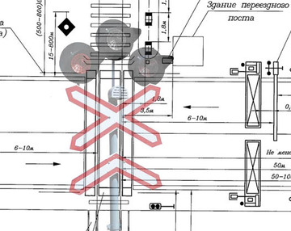
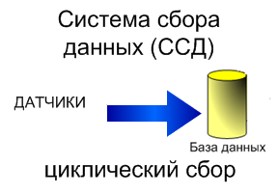
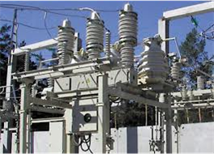
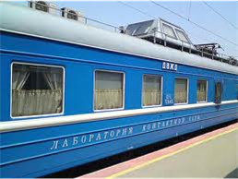
Кафедра «Локомотивы»
ДВГУПС
Certified by Russian Register
ДВГУПС
Certified by Russian Register
Мониторинг объектов инфраструктуры железнодорожного транспорта
Контроль основных параметров железнодорожных объектов
Геопривязка и беспроводная, оперативная передача данных
IP-сети
VPN-сеть
ГИС-системы
Технологии
OLAP,
Data Mining

Slide 3
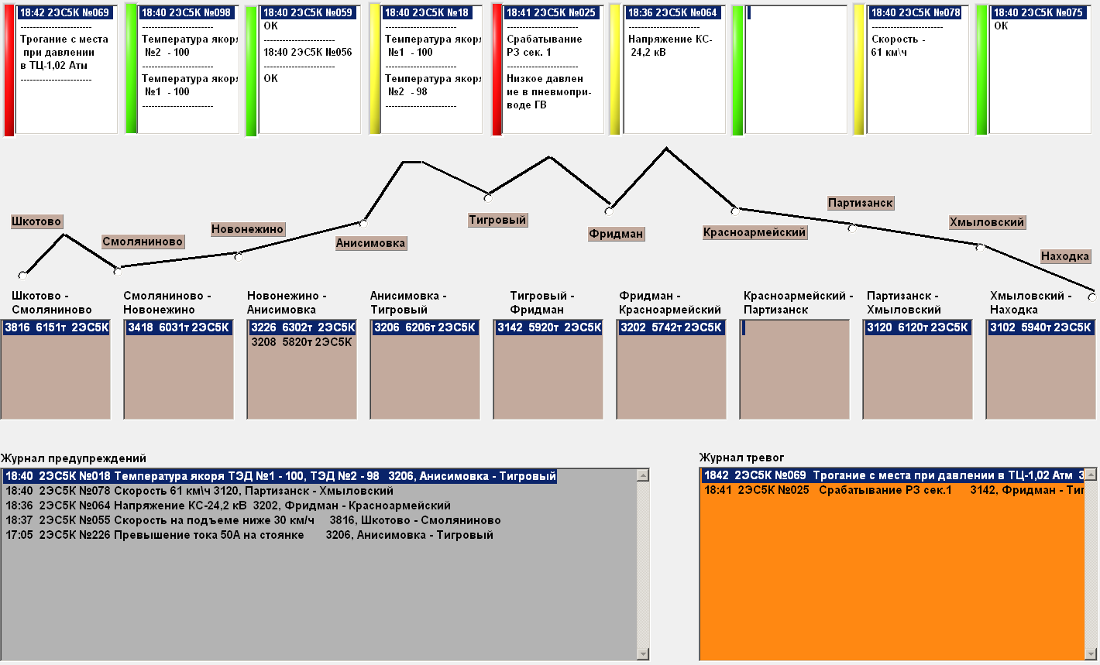
Кафедра «Локомотивы»
ДВГУПС
Certified by Russian Register
ДВГУПС
Certified by Russian Register
Мониторинг объектов на участке обращения локомотива

Slide 4
Кафедра «Локомотивы»
ДВГУПС
Certified by Russian Register
ДВГУПС
Certified by Russian Register
Отображение оперативных данных с тяговых подстанций на диспетчерском пункте

Slide 5
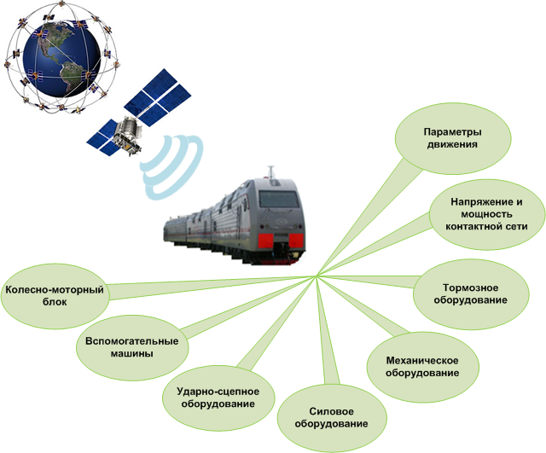
Кафедра «Локомотивы»
ДВГУПС
Certified by Russian Register
ДВГУПС
Certified by Russian Register
Мониторинг тягового подвижного состава
Токовые нагрузки контакторов
Напряжение и ток трансформатора
Температура нагрева узлов и агрегатов локомотива
Токи и напряжения ТЭД и вспомогательных машин
Динамические воздействия на элементы локомотива
Распределение токов по фазам электрических машин
Давление в тормозных системах и подсыпка песка
Определение фактического состояния оборудования локомотива
Формирование оперативных данных
Режимы работы обмоток собственных нужд
Усилия на автосцепках локомотива
Частота оборотов КП и валов электрических машин
Notes:
3-D cyclical shapes
(Difficult)
Tip: Some shape effects on this slide are created with the Combine Shapes commands. To access this command, you must add it to the Quick Access Toolbar, located above the File tab. To customize the Quick Access Toolbar, do the following:
Click the arrow next to the Quick Access Toolbar, and then under Customize Quick Access Toolbar click More Commands.
In the PowerPoint Options dialog box, in the Choose commands from list, select All Commands.
In the list of commands, click Combine Shapes, and then click Add.
To reproduce the first shape on this slide, do the following:
On the Home tab, in the Slides group, click Layout, and then click Blank.
Also on the Home tab, in the Drawing group, click Shapes, and then under Basic Shapes click Oval (first row).
On the slide, drag to draw an oval.
Select the oval. Under Drawing Tools, on the Format tab, in the Size group, enter 4.25” into the Height box and 4.25” into the Width box.
Also on the Format tab, in the Shape Styles group, click Shape Fill, and then click No Fill.
On the Home tab, in the Drawing group, click Shapes, and then under Basic Shapes click Pie (second row).
On the slide, drag to draw a pie.
Select the pie shape. Under Drawing Tools, on the Format tab, in the Size group, enter 4” into the Height box and 4” into the Width box.
Press and hold CTRL, and select the oval and the pie. Also on the Format tab, in the Arrange group, click Align, and then do the following:
Click Align to Slide.
Click Align Center.
Click Align Middle
Select the pie shape. Drag the yellow diamond adjustment handles to create a half-circle shape, with the rounded edge facing the top of the slide.
On the Home tab, in the Drawing group, click Shapes, and then under Basic Shapes click Oval (first row)
On the slide, drag to draw an oval.
Select the second oval. Under Drawing Tools, on the Format tab, in the Size group, enter 3” into the Height box and 3” into the Width box.
Move the second oval to the center of the first oval.
Press and hold CTRL, and select the pie and the second oval. Also on the Format tab, in the Arrange group, click Align, and then do the following:
Click Align Selected Objects.
Click Align Right.
Click Align Middle.
Press and hold CTRL, select the pie, and then select the second oval. On the Quick Access Toolbar, click Combine Shapes, and then click Shape Subtract.
Also on the Home tab, in the Drawing group, click Shapes, and under Basic Shapes click Oval.
On the slide, drag to draw an oval.
Select the new oval. Under Drawing Tools, on the Format tab, in the Size group, enter 1” into the Height box and 1” into the Width box.
Select the new oval. Also on the Format tab, in the Arrange group, do the following:
Click Align to Slide.
Click Align Middle.
Click Align Center.
Press and hold CTRL, and select the new oval and the freeform shape. Also on the Format tab, in the Arrange group, do the following:
Click Align Selected Objects.
Click Align left.
Press and hold CTRL, and select the new oval and the freeform shape. On the Quick Access Toolbar, click Combine Shapes, and then click Shape Union.
To reproduce the second and third curved freeform shapes, do the following:
Press and hold CTRL, and select the freeform shape and the oval. Also on the Format tab, in the Arrange group, click Group, and the click Group.
Select the group of shapes. On the Home tab, in the Clipboard group, click the arrow to the right of Copy, and then click Duplicate.
Select the duplicate group of shapes. Under Drawing Tools, on the Format tab, in the Size group, click the Size and Position dialog box launcher. In the Format Shape dialog box, click Size in the left pane, and in the Size pane, under Size and rotate, in the Rotation box enter 120°.
Press and hold CTRL, and select both groups of shapes. Also on the Format tab, in the Arrange group, do the following:
Click Align to Slide.
Click Align Middle.
Click Align Center.
Select the first group of shapes. On the Home tab, in the Drawing group, click Arrange, and then click Ungroup.
Select the duplicate group of shapes. On the Home tab, in the Drawing group, click Arrange, and then click Ungroup.
Press and hold CTRL, select the first freeform shape, and then the duplicate freeform shape. On the Quick Access Toolbar, click Combine Shapes, and then click Shape Subtract.
Press and hold CTRL, and select the freeform shape and an oval. On the Home tab, in the Drawing group, click Arrange, and then click Group.
Select the group. On the Home tab, in the Clipboard group, click the arrow to the right of Copy, and then click Duplicate. Repeat this process until there is a total of three groups.
Select a group. Under Drawing Tools, on the Format tab, in the Size group, click the Size and Position dialog box launcher. In the Format Shape dialog box, click Size in the left pane, and in the Size pane, under Size and rotate, in the Rotation box enter 120°.
Select another group. Under Drawing Tools, on the Format tab, in the Size group, click the Size and Position dialog box launcher. In the Format Shape dialog box, click Size in the left pane, and in the Size pane, under Size and rotate, in the Rotation box enter 240°.
Press and hold CTRL, and select all three groups of shapes. Also on the Format tab, in the Arrange group, do the following:
Click Align to Slide.
Click Align Middle.
Click Align Center.
Select a group. Under Drawing Tools, on the Format tab, in the Arrange group, click Ungroup. Repeat this process for each of the groups.
Select an oval and then press DELETE to delete the oval. Repeat the process for each oval.
Select the top, left freeform shape. Under Drawing Tools, on the Format tab, in the Shape Styles group, click the Format Shape dialog box launcher. In the Format Shape dialog box, click Fill in the left pane, in the Fill pane, select Solid fill, and then click the button next to Color, under Theme Colors, click Olive Green, Accent 3, Darker 25%.
Also in the Format Shape dialog box, click 3-D Format in the left pane, and in the 3-D Format pane, do the following:
Under Bevel, click the button next to Top, and then click Slope.
Next to Top, in the Width box, enter 10 pt.
Next to Top, in the Height box, enter 5 pt.
Under Depth, click the button next to Color and then click Olive Green, Accent 3, Darker 25%.
Also under Depth, in the Depth box, enter 36 pt.
Select the bottom freeform shape. Under Drawing Tools, on the Format tab, in the Shape Styles group, click Shape Fill, point to Gradients, and then click More Gradients. In the Format Shape dialog box, click Fill in the left pane, in the Fill pane , click Gradient fill, and then do the following:
In the Type list, click Linear.
In the Angle box, enter 0°.
Under Gradient stops, click Add gradient stops or Remove gradient stops until three stops appear in the slider.
Also under Gradient stops, select Rotate with shape.
Also under Gradient stops, customize the gradient stops as follows:
Select the first stop in the slider, and then do the following:
In the Position box, enter 0%.
Click the button next to Color, click More Colors, and then in the Colors dialog box, on the Custom tab, enter values for Red: 129, Green: 84, and Blue: 25.
In the Transparency box, enter 0%.
Select the next stop in the slider, and then do the following:
In the Position box, enter 20%.
Click the button next to Color, click More Colors, and then in the Colors dialog box, on the Custom tab, enter values for Red: 204, Green: 151, and Blue: 0.
In the Transparency box, enter 0%.
Select the last stop in the slider, and then do the following:
In the Position box, enter 81%.
Click the button next to Color, click More Colors, and then in the Colors dialog box, on the Custom tab, enter values for Red: 255, Green: 236, and Blue: 93.
In the Transparency box, enter 0%.
Also in the Format Shape dialog box, click 3-D Format in the left pane, and in the 3-D Format pane, do the following:
Under Bevel, click the button next to Top, and then click Slope.
Next to Top, in the Width box, enter 10 pt.
Next to Top, in the Height box, enter 5 pt.
Under Depth, click the button next to click More Colors, and then in the Colors dialog box, on the Custom tab, enter values for Red: 129, Green: 84, and Blue: 25.
Also under Depth, in the Depth box, enter 36 pt.
Select the right freeform shape. Under Drawing Tools, on the Format tab, in the Shape Styles group, click Shape Fill, point to Gradients, and then click More Gradients. In the Format Shape dialog box, click Fill in the left pane, in the Fill pane , click Gradient fill, and then do the following:
In the Type list, click Linear.
In the Angle box, enter 0.
Under Gradient stops, click Add gradient stops or Remove gradient stops until three stops appear in the slider.
Also under Gradient stops, select Rotate with shape.
Also under Gradient stops, customize the gradient stops as follows:
Select the first stop in the slider, and then do the following:
In the Position box, enter 0%.
Click the button next to Color, click More Colors, and then in the Colors dialog box, on the Custom tab, enter values for Red: 117, Green: 21, and Blue: 21.
In the Transparency box, enter 0%.
Select the next stop in the slider, and then do the following:
In the Position box, enter 30%.
Click the button next to Color, click More Colors, and then in the Colors dialog box, on the Custom tab, enter values for Red: 194, Green: 40, and Blue: 14.
In the Transparency box, enter 0%.
Select the last stop in the slider, and then do the following:
In the Position box, enter 74%.
Click the button next to Color, click More Colors, and then in the Colors dialog box, on the Custom tab, enter values for Red: 243, Green: 72, and Blue: 3.
In the Transparency box, enter 0%.
Also in the Format Shape dialog box, click 3-D Format in the left pane, and in the 3-D Format pane, do the following:
Under Bevel, click the button next to Top, and then click Slope.
Next to Top, in the Width box, enter 10 pt.
Next to Top, in the Height box, enter 5 pt.
Under Depth, click the button next to click More Colors, and then in the Colors dialog box, on the Custom tab, enter values for Red: 117, Green: 21, and Blue: 21.
Also under Depth, in the Depth box, enter 36 pt.
Press and hold CTRL, and select all three freeform shapes. On the Home tab, in the Drawing group, click Arrange, and then click Group.
Select the group. Also on the Home tab, in the Drawing group, click the Format Shape dialog box launcher. In the Format Shape dialog box, click 3-D Rotation in the left pane, in the 3-D Rotation pane, click the button next to Presets, and then under Perspective, click Perspective Relaxed Moderately.
Also in the Format Shape dialog box, click Shadow in the left pane, and in the Shadow pane, do the following:
Click the button next to Presets, under Perspective, click Below.
In the Transparency box, enter 70%.
In the Size box, enter 90%.
In the Blur box, enter 26 pt.
In the Angle box, enter 90°.
In the Distance box, enter 0 pt.
To reproduce the background effects on this slide, do the following:
On the Design tab, in the Background group, click Background Styles, and then click Format Background. In the Format Background dialog box, click Fill in the left pane, in the Fill pane, click Gradient fill, and then do the following:
In the Type list, click Linear.
In the Angle box, enter 90°.
Under Gradient stops, click Add gradient stops or Remove gradient stops until two stops appear in the slider.
Also under Gradient stops, customize the gradient stops as follows:
Select the first stop in the slider, and then do the following:
In the Position box, enter 0%.
Click the button next to Color, and then under Theme Colors click Black, Text 1 (first row).
Select the next stop in the slider, and then do the following:
In the Position box, enter 19%.
Click the button next to Color, and then under Theme Colors click Black, Text 1, Lighter 35% (third row).
Select the final stop in the slider, and then do the following:
In the Position box, enter 62%.
Click the button next to Color, and then under Theme Colors click White, Background 1, Darker 15% (first row, first option from the left).

Slide 6
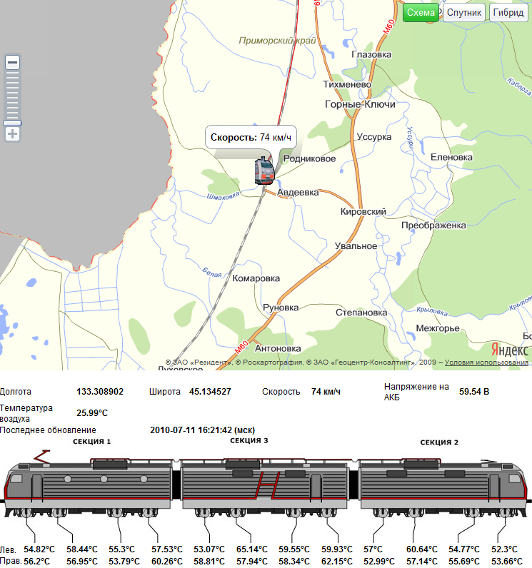
Кафедра «Локомотивы»
ДВГУПС
Certified by Russian Register
ДВГУПС
Certified by Russian Register
Интерактивный контроль оперативных данных
Нагрев МОП
Параметры основного оборудования

Slide 7
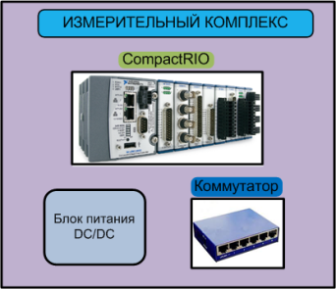
Кафедра «Локомотивы»
ДВГУПС
Certified by Russian Register
ДВГУПС
Certified by Russian Register
Диагностирование узлов локомотива
Контроль параметров лимитирующих узлов локомотива в реальном режиме времени
Токи и напряжения ТЭД
Температура обмоток
Сопротивление изоляции
Температура МОП
Расход смазки МОП и редуктора
Колесно-моторный блок
Аналитический центр
Токи и напряжения машин
Температура обмоток
Сопротивление изоляции
Вибрации
Распределение токов по фазам
Вспомогательные машины
Аналитическая оценка фактического состояния и тренда характеристики, с целями:
Создания информационной (диагностической) карты;
Определения фактического ремонта;
Формирования плана захода локомотивов на ремонт;
Оптимальной загрузки ремонтных ресурсов.
Усилия на автосцепках
Ускорение по трем осям
Перемещения поглощающего
аппарата
Синхронизация с напряжением
ТЭД и частотой вращения КП
Автосцепное оборудование
Тормозное оборудование
Давление в тормозной магистрали и тормозных цилиндрах
Расход песка
Силовое оборудование
Температура нагрева тягового трансформатора
Напряжение и ток на обмотках трансформатора
Контроль параметров оборудования в условиях депо
Замеры параметров проблемных узлов стационарными методами

Slide 8
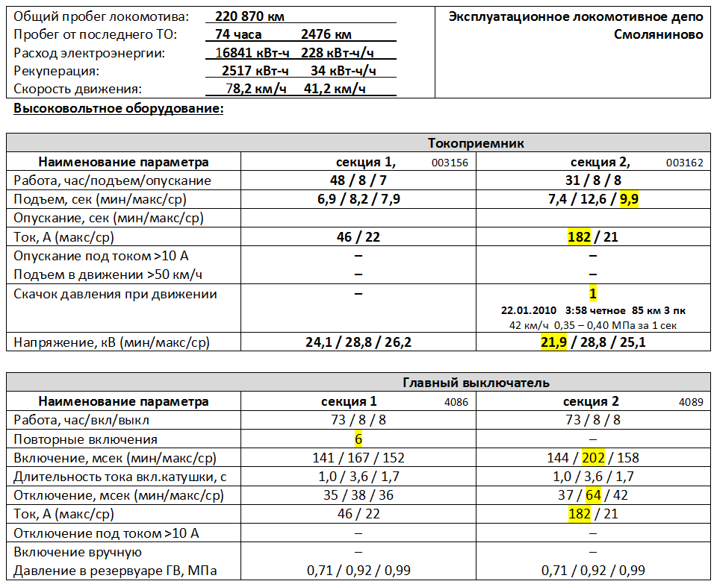
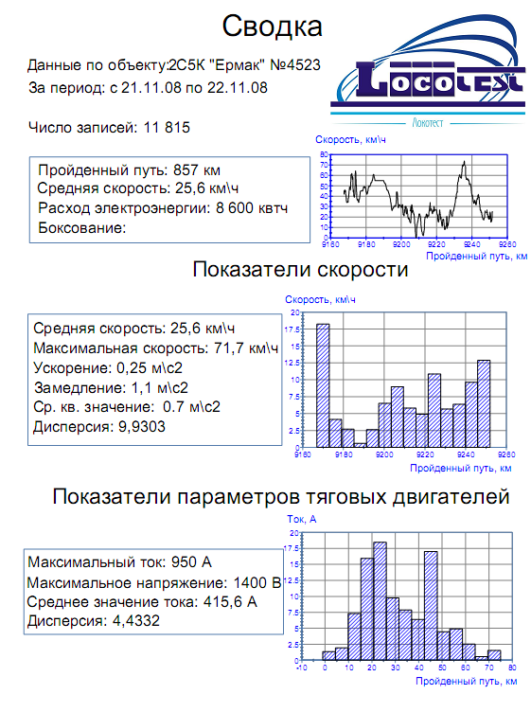
Кафедра «Локомотивы»
ДВГУПС
Certified by Russian Register
ДВГУПС
Certified by Russian Register
Формирование оперативных данных

Slide 9
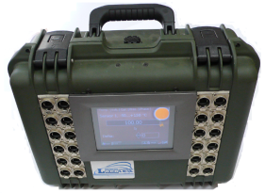
Кафедра «Локомотивы»
ДВГУПС
Certified by Russian Register
ДВГУПС
Certified by Russian Register
Испытания подвижного состава
Типы испытаний
Технология испытаний
Проектный этап
Проведение испытаний
Заключительный этап
Определение весовых норм поездов с учетом фактических условий эксплуатации
(Электротяговые, теплотехнические, продольно-динамические, тормозные и др.)
Определение возможности применения различных видов тяги (распределенная тяга, кратная тяга, применение подталкивания)
Определение характеристик и надежности работы узлов и агрегатов подвижного состава
Определение взаимного влияния объектов инфраструктуры железнодорожного транспорта
Интерактивные, автономные измерительные системы устанавливаемые на подвижной состав
Мобильные телеметрические комплексы
Комплексные испытания с использованием испытательных вагонов ОАО «РЖД»
Разработка ТЗ
Определение объема и типа испытаний
Определение технологии испытаний
Разработка и согласование программы испытаний
Разработка требуемых инструкций по проведению испытаний
Проведение предварительных расчетов и моделирование отдельных «ситуаций»
Составление технологической карты испытаний с определением и унификацией требуемого оборудования
Выезд на объект испытания с предварительной оценкой приоритета работ
Монтаж и запуск испытательного оборудования
Проведение серии опытных поездок с целью определения всех требуемых эксплуатационных характеристик
Обеспечение непрерывного on-line мониторинга испытываемых объектов в течение всего времени эксперимента
Натурные исследования испытуемых объектов
Проведение специализированных экспертиз и лабораторных исследований отдельных объектов
Фиксирование ограничений и нестационарных режимов
Подготовка отчета по итогам испытаний:
Обобщение результатов замеров параметров работы исследуемых объектов
Сопоставление фактических эксплуатационных с расчетными и моделируемыми параметрами
Дополнительные расчеты и составление моделей
Подготовка экспертного заключения
Подготовка выводов и рекомендаций по итогам испытаний

Slide 10
Кафедра «Локомотивы»
ДВГУПС
Certified by Russian Register
ДВГУПС
Certified by Russian Register
Научно-техническое сопровождение новой и
модернизированной техники
Контроль согласованных с разработчиком параметров и характеристик устройств
Оценка надежности работы оборудования в зависимости от эксплуатационных параметров
Подготовка обоснованных предложений по модернизации техники и технологий
Проведение комплексных испытаний подвижного состава и отдельных агрегатов
Оценка эффективности внедрения инновационных технологий на транспорте
Установка и контроль работоспособности модернизированных и вновь разрабатываемых узлов

Slide 11
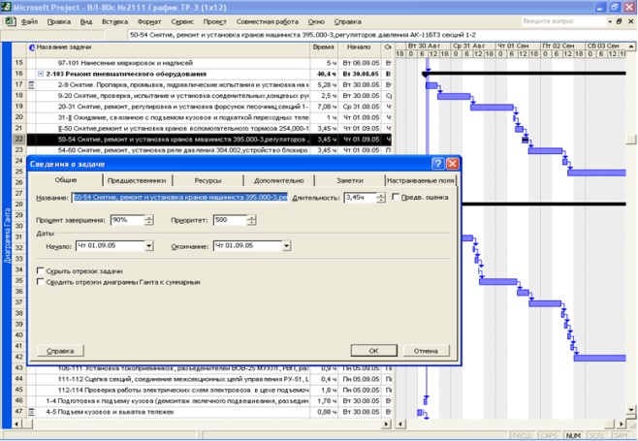
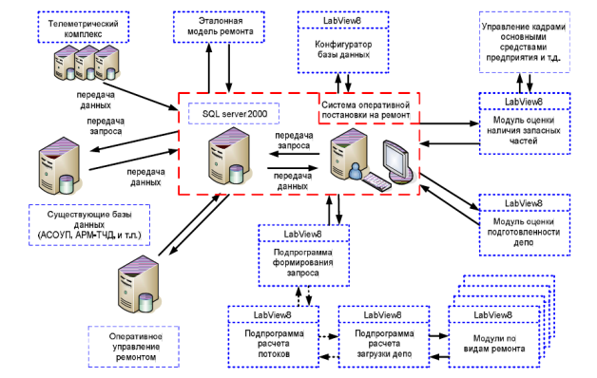
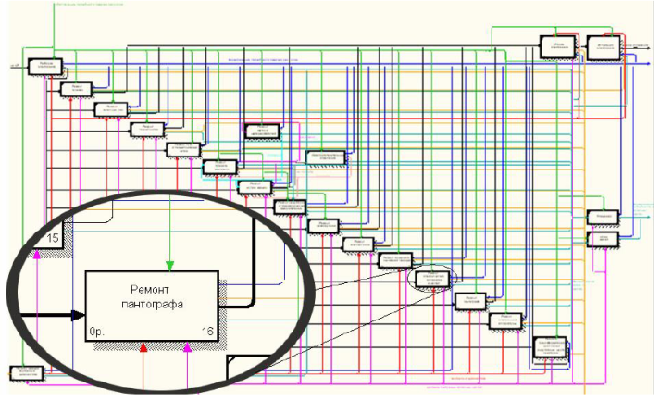
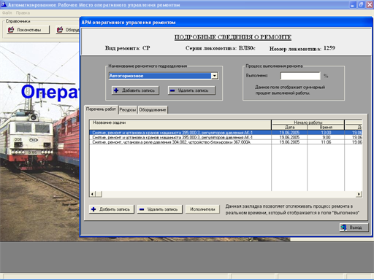
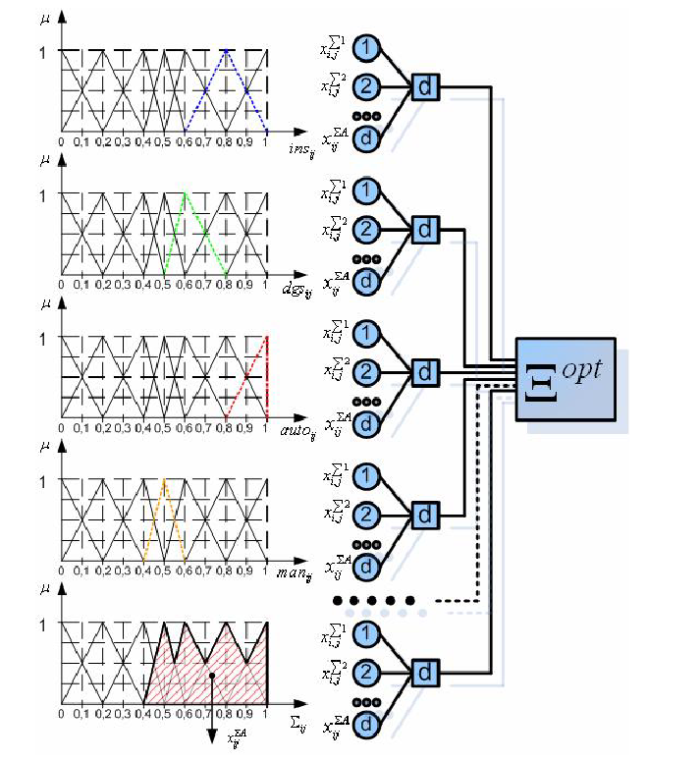
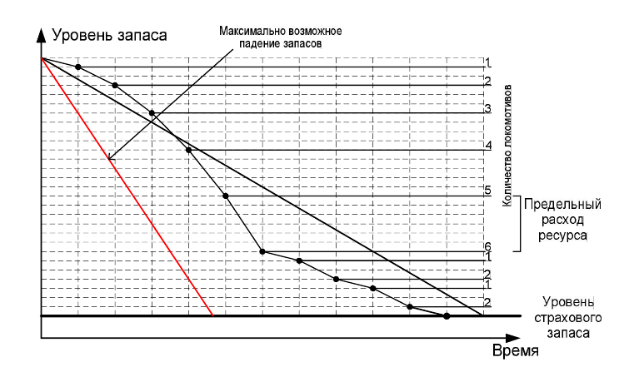
Кафедра «Локомотивы»
ДВГУПС
Certified by Russian Register
ДВГУПС
Certified by Russian Register
Оптимизация процессов ремонта локомотивов
Оптимизация производственного процесса
Разработка системы постановки ТПС на ремонт по фактическому состоянию
Разработка систем оперативного управления ремонтом
Совершенствование технологии ремонта подвижного состава
Внедрение современных технологий подготовки производства
Формирование оптимального ресурсного парка

Slide 12
Кафедра «Локомотивы»
ДВГУПС
Certified by Russian Register
ДВГУПС
Certified by Russian Register
Проектирование автоматизированных систем управления
ERP (АСУП)
Система оперативной постановки локомотивов на ремонт
MES (АСОДУ)
АСУТП
Оперативно-диспетчерское управление процессом ремонта локомотивов
Комплексы контроля параметров узлов локомотивов и загрузки технологического оборудования

Slide 13
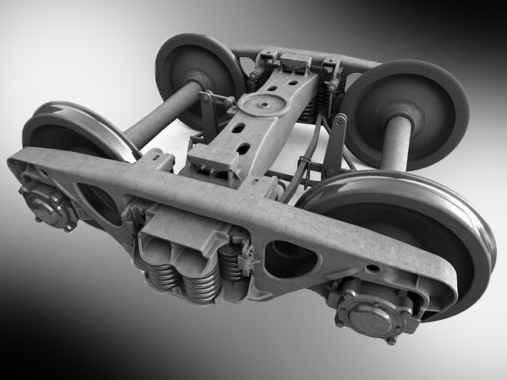
Кафедра «Локомотивы»
ДВГУПС
Certified by Russian Register
ДВГУПС
Certified by Russian Register
Исследования взаимодействия колеса и рельса
Исследование процесса вписывания тележек подвижного состава в кривые
Оценка сил, действующих на экипажную часть при движении по кривым участкам пути
Анализ факторов, влияющих на износ колесных пар и рельс в реальных условиях эксплуатации и ремонта
Технико-технологические предложения по улучшению вписывания тележек в кривые и уменьшению износа

Slide 14
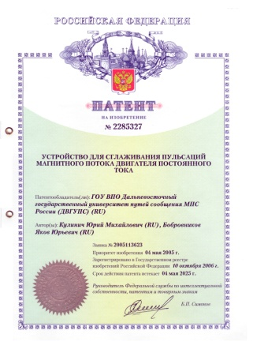
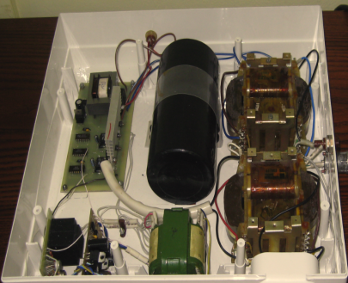
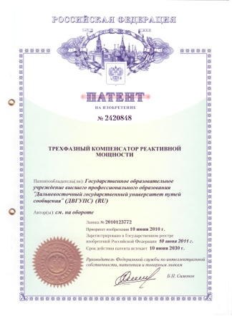
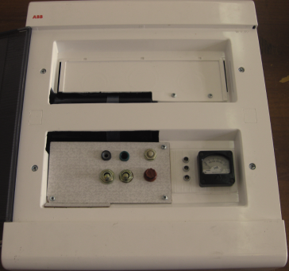
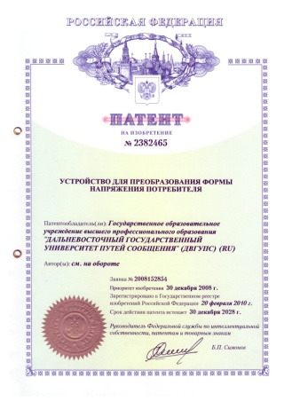
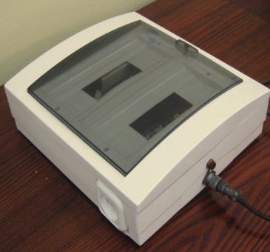
Кафедра «Локомотивы»
ДВГУПС
Certified by Russian Register
ДВГУПС
Certified by Russian Register
Снижение непроизводительных затрат электроэнергии
Направления
Техническая реализация
Повышение энергетических показателей электровоза переменного тока путем снижения пульсаций в цепи выпрямленного тока
Компенсатор реактивной составляющей тока потребления
Повышение эффективности потребления электрической энергии в локомотивном депо путём активной фильтрации потребляемого тока
Трехфазный компенсатор высших гармонических составляющих потребляемого тока
Повышение качества электрической энергии в системе тягового электроснабжения переменного тока путём повышения синусоидальности питающего напряжения
Компенсатор искажения напряжения

Slide 15
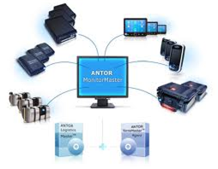
Кафедра «Локомотивы»
ДВГУПС
Certified by Russian Register
ДВГУПС
Certified by Russian Register
Развитие кадрового потенциала
Подготовка кадров по специальности «Подвижной состав железных дорог»
Программы повышения квалификации и переподготовки кадров
Безопасность движения поездов
Электро-подвижной состав
Бережливое производство
Диспетчерские системы управления ремонтом локомотива
Современные технологии автоматизации ЖДТ
Локомотивы
Сертификация производства по отраслям ЖД транспорта

Slide 16
Кафедра «Локомотивы»
ДВГУПС
Certified by Russian Register
ДВГУПС
Certified by Russian Register
КОНТАКТНАЯ ИНФОРМАЦИЯ
Адрес
Контактные лица
г. Хабаровск, ул. Серышева, 47. Ауд. 3115
Пляскин Артем Константинович
доцент,
кандидат технических наук,
заведующий кафедрой
Организация
Дальневосточный государственный университет
путей сообщения
Кафедра
«Локомотивы»
WWW
ДВГУПС.рф (DVGUPS.ru)
@
loc@festu.khv.ru
телефон
(4212) 407-097
факс
(4212) 407-356

